Slide 1




CELESTIAL ODYSSEY
PLANETARY TOURISM OFFICE
TEAM INVINCIBLE
2023 NASA INTERNATIONAL SPACE APPS CHALLENGE
MEMBERS
UTSAV ACHARYA
DARSHAN KR. PAUDYAL
RABIN LAMICHHANE
ATUL TIWARI
SAPHAL UPRETI
SADINA UPRETI

Slide 2


OUR OBJECTIVE
TO INCULCATE THE KIDS ABOUT SPACE AND BODIES OF THE SOLAR SYSTEM AND PROVIDE THEM THE AMBIANCE OF SOLAR TOURISM

Slide 3

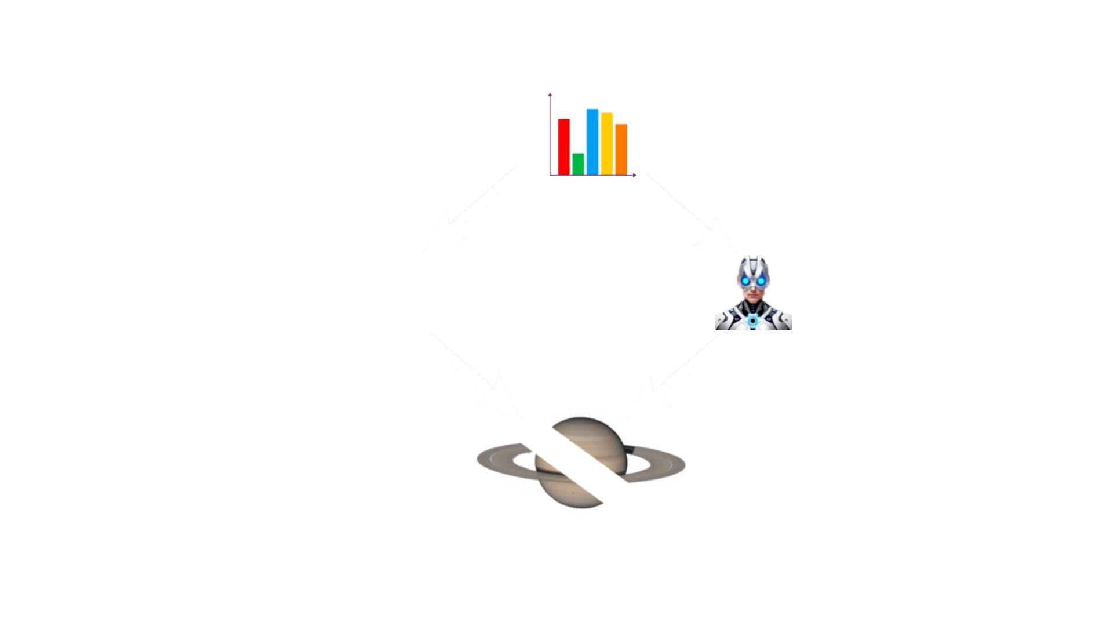
OVERVIEW

Slide 4
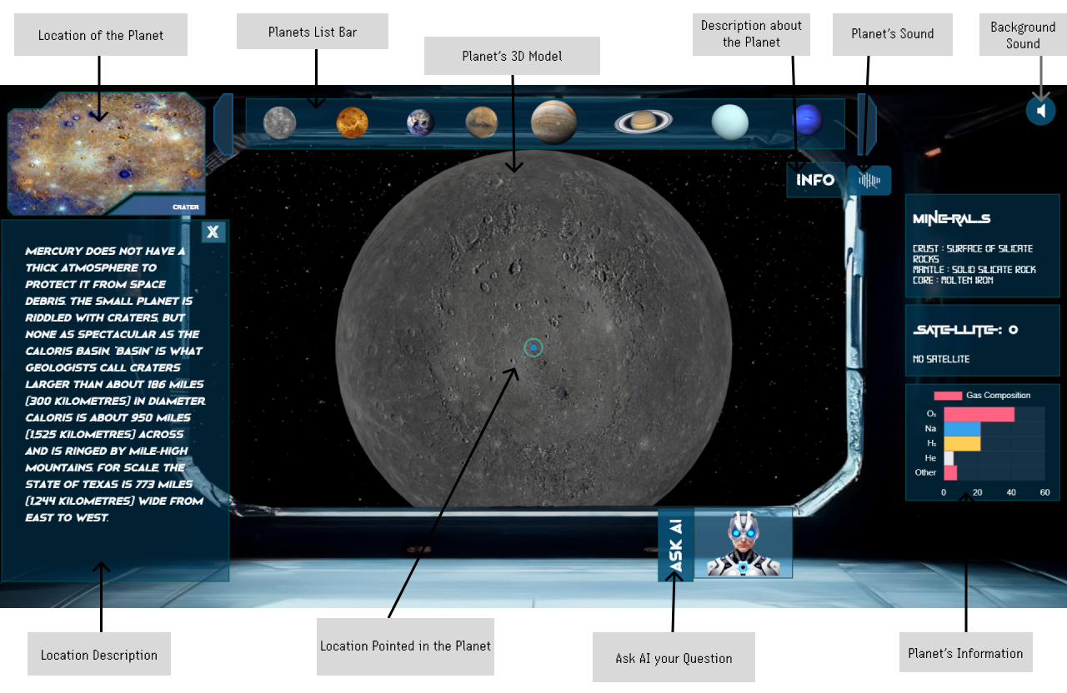
UI/UX
FOCUSING ON YOUNG MINDS, WE'VE CRAFTED A VISUALLY ENGAGING UI/UX THAT'S BOTH EDUCATIONAL AND EXCITING FOR KIDS.
FINDING YOUR CREATIVE NICHE | CHC 2020

Slide 5
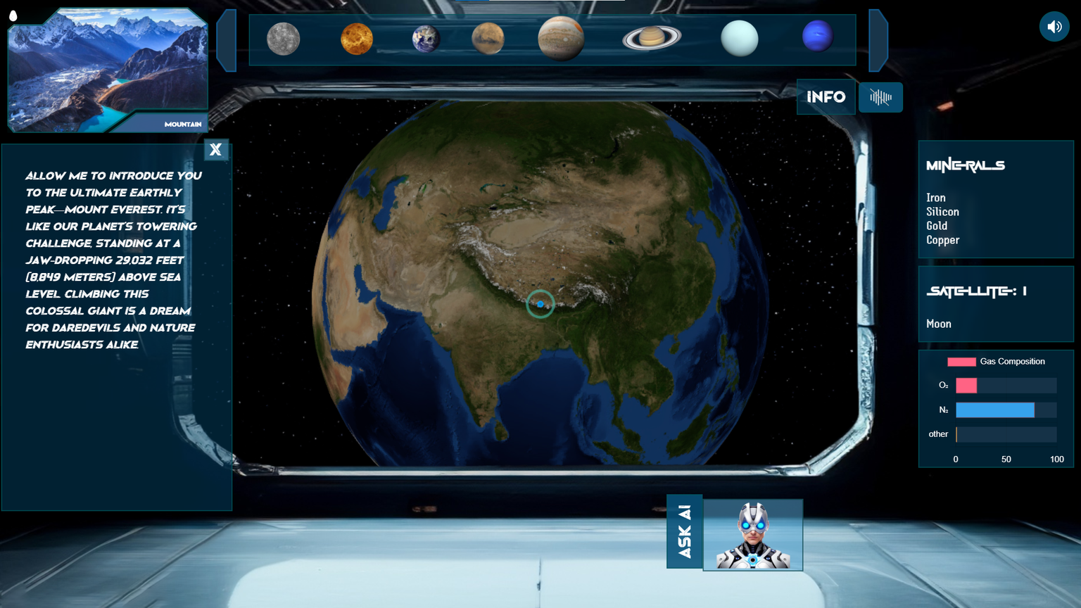
3D MODEL
WE EMPLOYED THREE.JS TO MANIPULATE THE 3D MODEL OF CELESTIAL BODIES WITH PRECISION AND FINENESS.

Slide 6
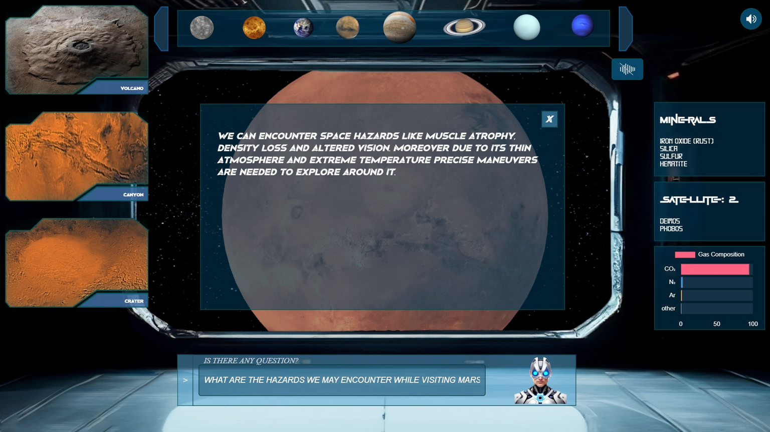
GENERATIVE AI
TO ENHANCE VIRTUAL COSMIC EXPERIENCE WE TRAINED A MODEL WITH 1 BILLION+ PARAMETERS

Slide 7
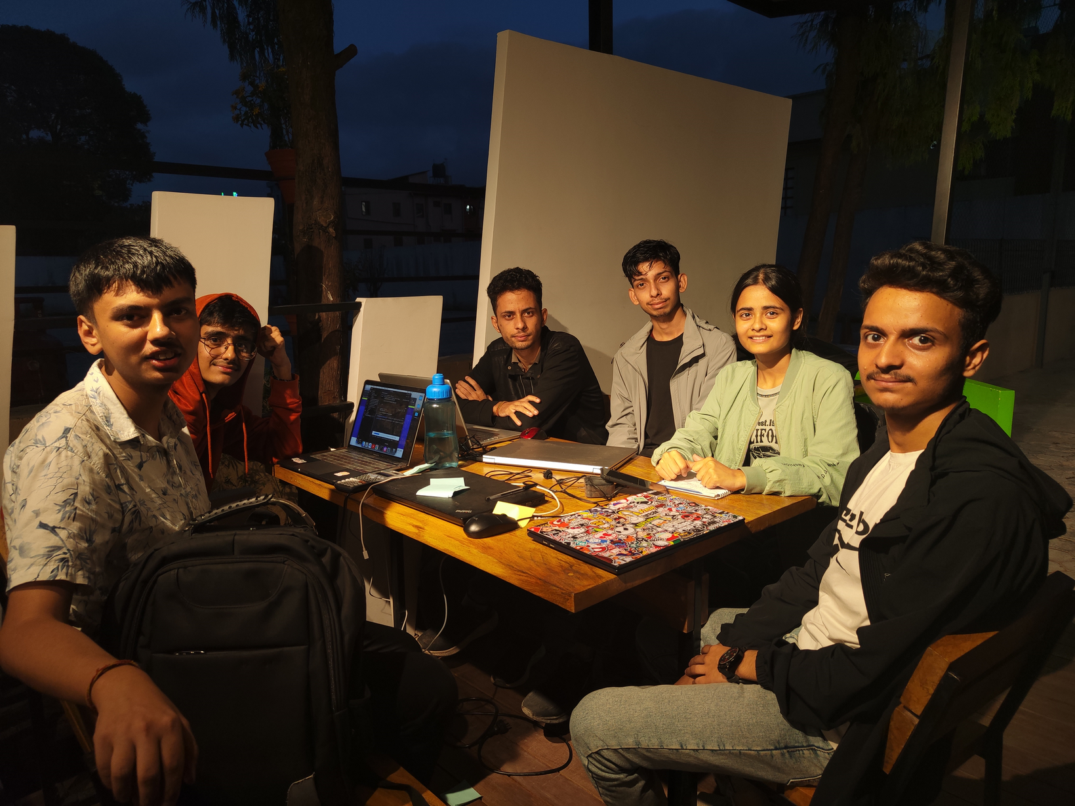
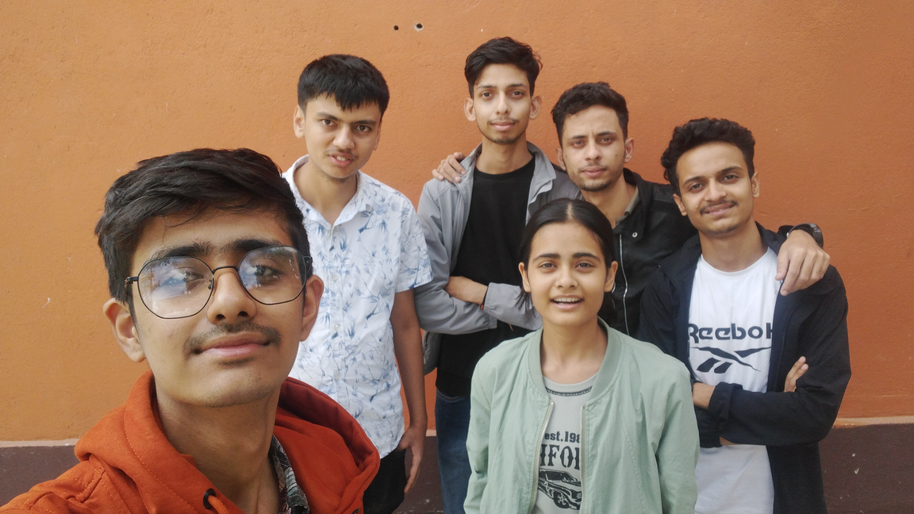
OUR EXPERIENCES
OVERALL, PARTICIPATING IN A HACKATHON WAS A FULFILLING EXPERIENCE THAT COMBINED TECHNICAL SKILLS, CREATIVITY, TEAMWORK, AND THE OPPORTUNITY TO MAKE A REAL IMPACT. AS A TEAM, WE INTEGRATE OUR DIVERSE SKILLS AND TALENTS TO TACKLE ALL THE CHALLENGES.

